Slide 1
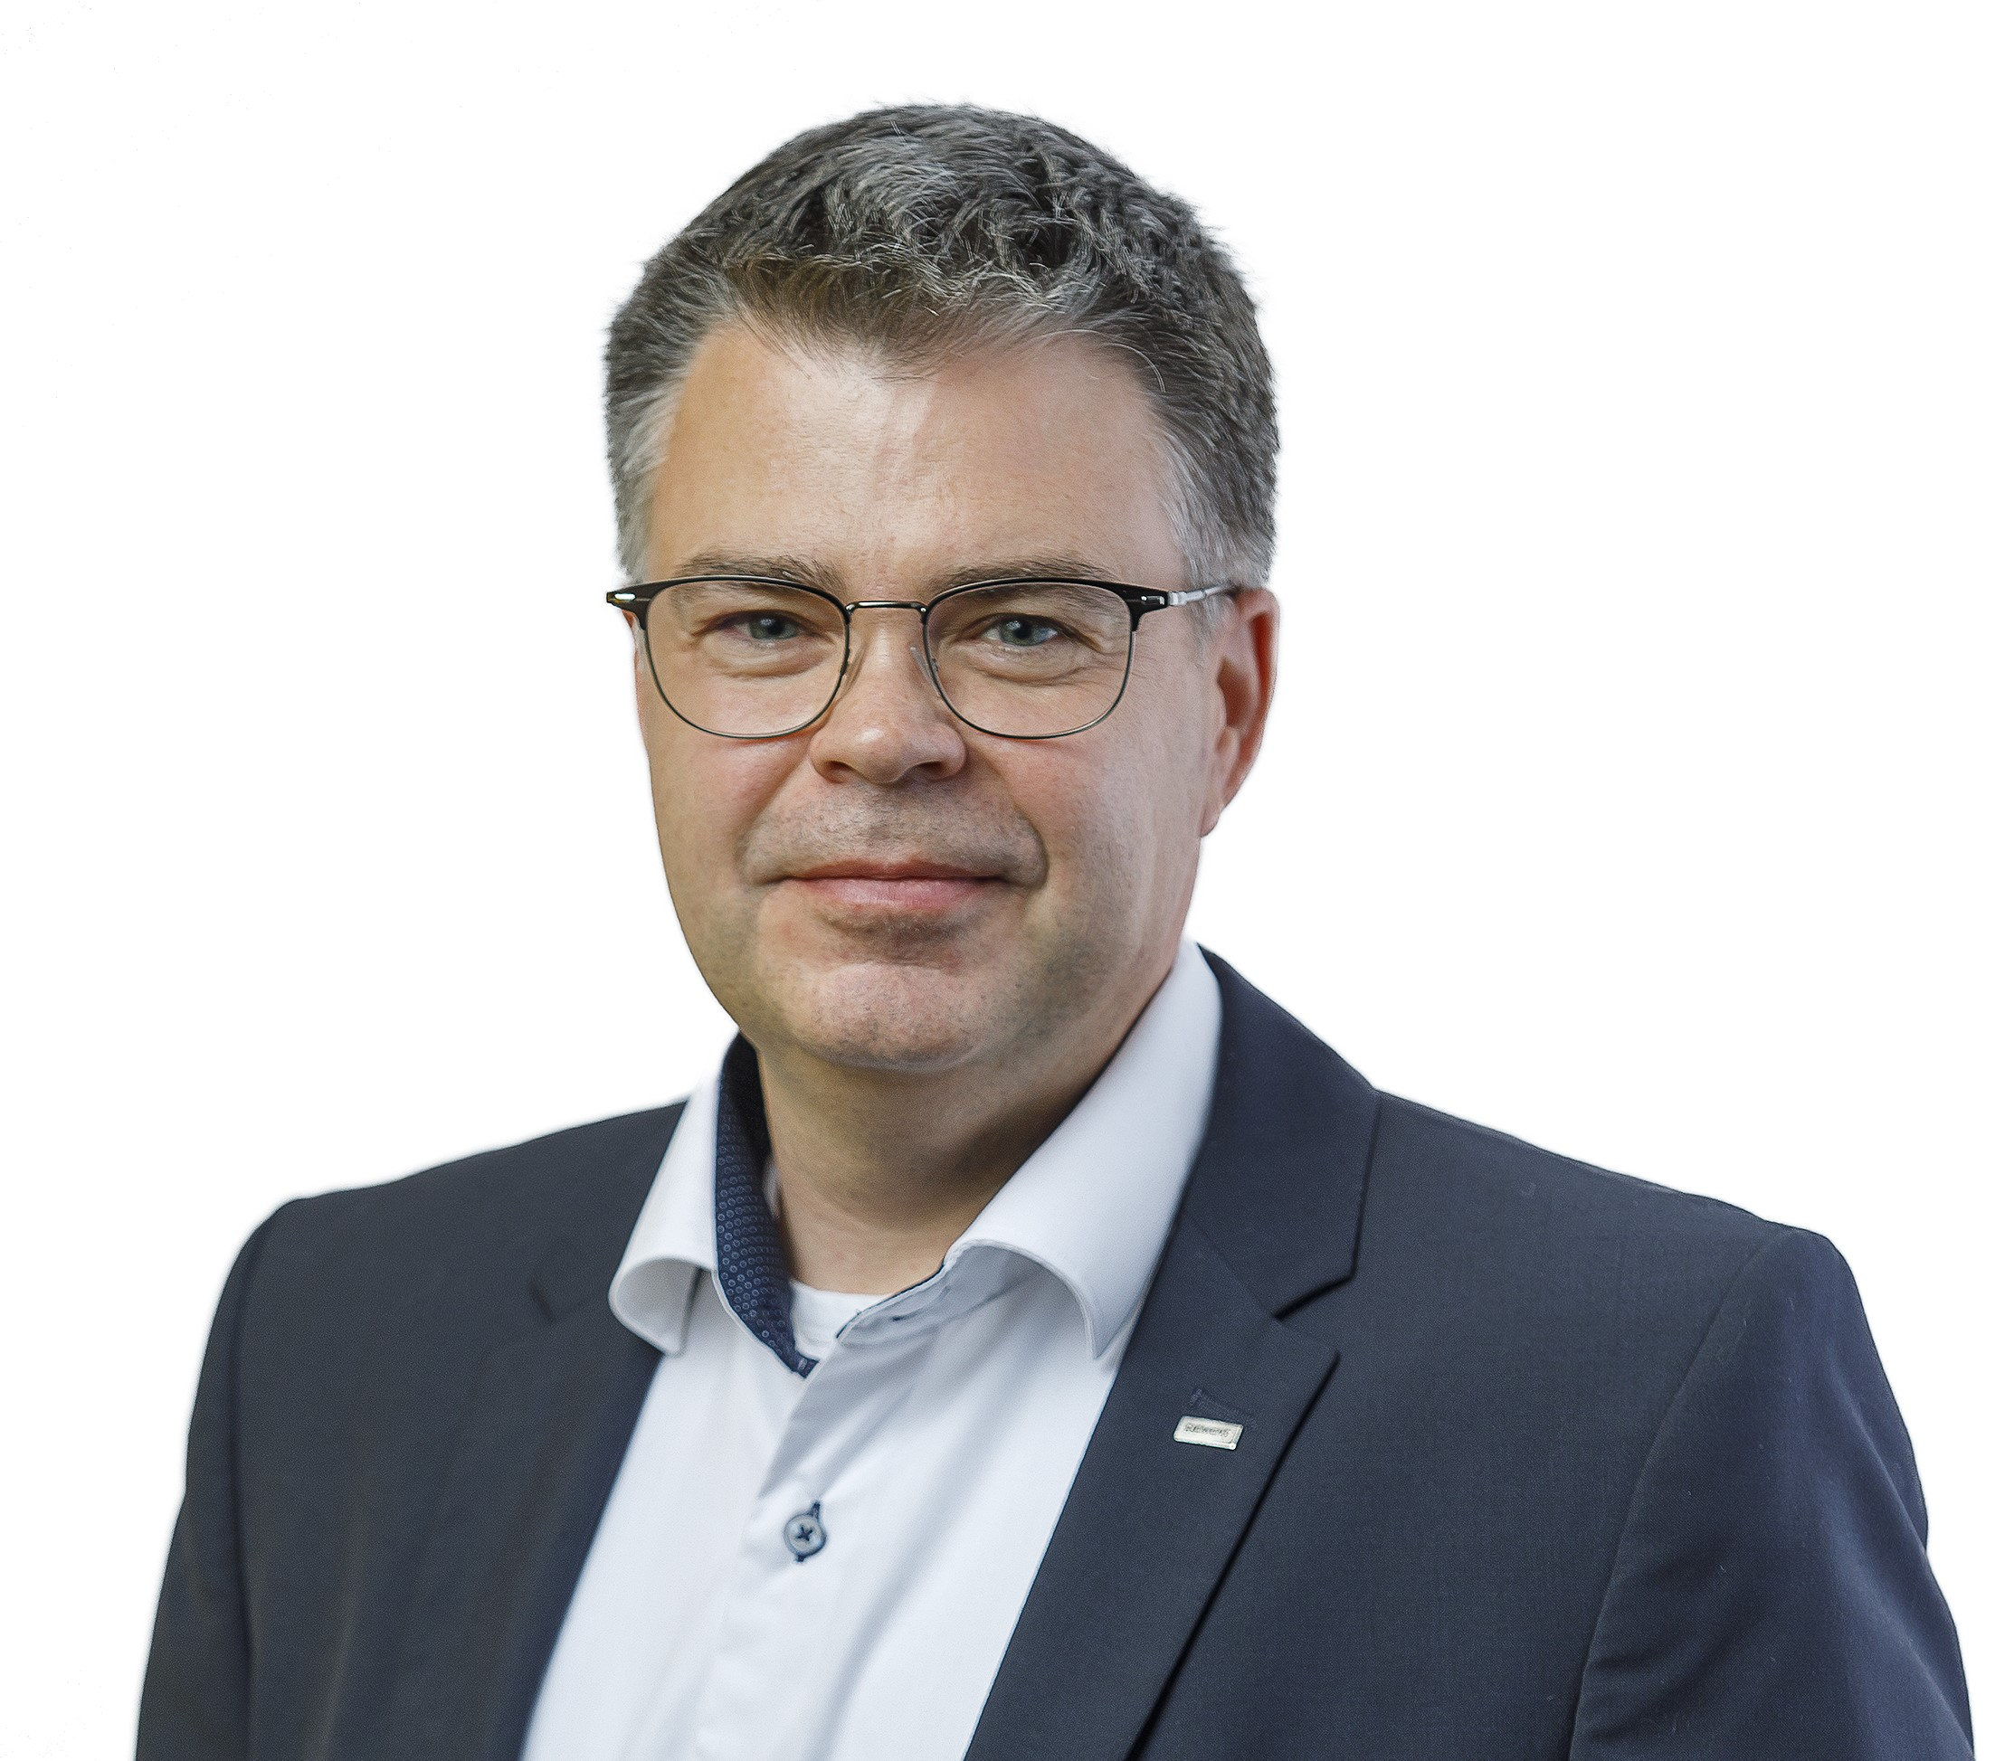
Simon Andras
Energy Management in the Industry sector
Sales Engineer
Siemens Zrt.
Our world is changing constantly. Data collection implies industrial sustainability and innovation.
Anyone who wants to manage energy costs, sustainabilityand equip their plant with integrated energy measurement systems in mind for the digital future ahead will put in place a transparent energy monitoring system linked to production and consumption.
The data’s and the additional informations it provides many benefits that it would be a crime to miss in today's fast-paced business and industrial environment.
In order to obtain these advantages, we collect data, including energy data, but the processing and display of these data it does not matter at all what hardware and software devices it is carried out with, since our primary goal is to ensure the highest possible level of transparency at the same time.
Our short presentation presents the world of data collection through examples.
Take an engine, that will soon be stuck for some reason, if you monitor its consumption and collect its data, you can easily deduce a failure that will occur soon and prevent further damage if you have the information.
andras.simon@siemens.com
My Name is Andras Simon.
I’ve been working at Siemens Hungary for almost 15 years ago.
In this 15 years I working together with electrical planners, panel builders, OEM-s and I’m responsible for energy management projects and sustainibility in industry.
Miskolc-Lillafüred
Hotel Palota**** 2-4. October 2023
Process Control
Systems Meeting

