Slide 1
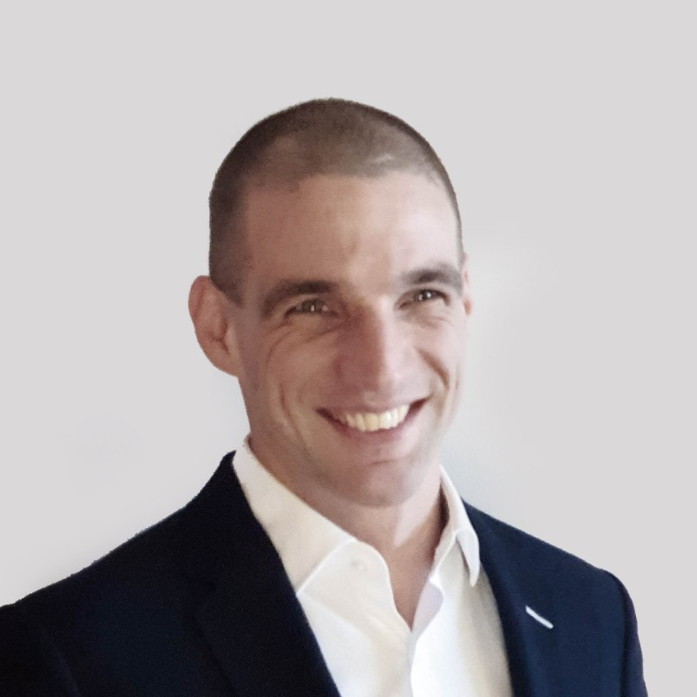
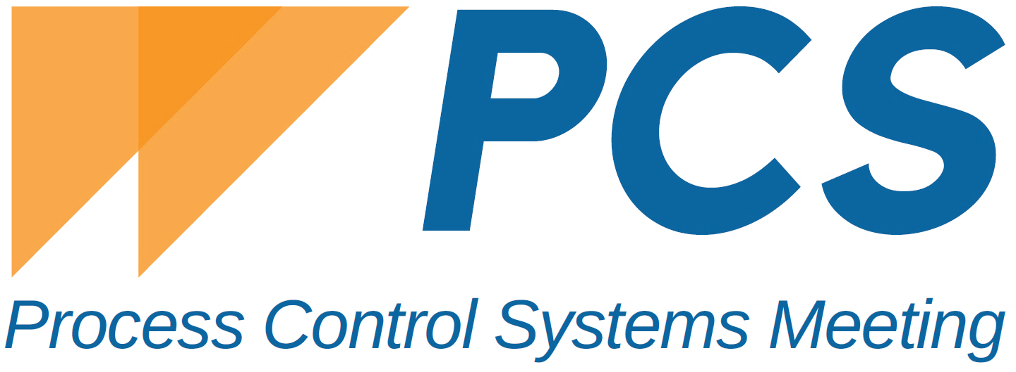
KOVÁCS Gergely
Smart compliance: Lifetime tracking of equipment with smart solutions, effectively
Operations manager
EPDS Szoftverfejlesztő Kft.
Identification of equipment is mandatory. All Directives, Schemes, related standards define the necessity of lifetime tracking. How can you do this if you have thousands of equipment? How do you follow up, if they are brought to the maintenance workshop? How do you ensure constant compliance and how do you ensure continuously up-to-date information about the status of all your equipment and hand over information to contractors, workers, audits or reports effectively?
For organizations dealing with thousands of equipment The need to track equipment throughout its entire lifecycle, is not only mandatory but also essential for operational efficiency and safety. EPDS system leads to a never seen efficiency and makes compliance a part of the daily routine. A comprehensive server-based solution ensures compliance on every level. RFID identification ensures easy asset identification while eliminating the risk of human errors and negative effects of chemicals and environmental influences. An easy to use and fully compliant RFID reader combined with mobile applications ensures immediate access of all relevant information and historical data of the equipment on site, thus make inspections and maintenance much faster.
One complete software and hardware solution, with enterprise level security, fully customizable, and handles contactors and auditors to make compliance easy.
kovacs@epds.hu
Gergely Kovács is the operations manager of EPDS Szoftverfejlesztő Kft. In the past 10 years he worked on national an international level creating tailormade solutions which enabled his partners to work boost their performance. His aim is to provide complete multi level solutions and be there at each phase of the project, to fully understand the operations and think together with all stakeholders to find the best possible solution for each situation.
Miskolc-Lillafüred
Hotel Palota**** 2-4. October 2023
Process Control
Systems Meeting

Slide 2
Identification of equipment is mandatory. All Directives, Schemes, related standards define the necessity of lifetime tracking. How can you do this if you have thousands of equipment? How do you follow up, if they are brought to the maintenance workshop? How do you ensure constant compliance and how do you ensure continuously up-to-date information about the status of all your equipment and hand over information to contractors, workers, audits or reports effectively?
For organizations dealing with thousands of equipment The need to track equipment throughout its entire lifecycle, is not only mandatory but also essential for operational efficiency and safety. EPDS system leads to a never seen efficiency and makes compliance a part of the daily routine.
A comprehensive server-based software solution to ensure compliance on every level and to adjust the industrial operation to internal and external regulatory systems and so mitigate the risk and parallel increase the safety of operation. Compliance with various standards and legal environments represents a major challenge for organizations. The EPDS framework system helps keep a record of all relevant issues, perform daily maintenance and inspection activities, and measure the requirements set by them. It also follows up all hazardous area and labor related requirements, giving a complete overview of our organization. Immediate reports and continuously accessible documentations show exactly to what extent the organization, the processes and their assets conform to the relevant standards.
RFID identification ensures easy asset identification while eliminating the risk of human errors and negative effects of chemicals and environmental influences. It is one single solution for identification and follow up of all your assets in any hazardous area industries. All activities from installation in including maintenance, repair, relocation, etc. can be tracked vis using ExRFID.
Smart compliance: Lifetime tracking of equipment with smart solutions, effectively
GERGELY Kovács
Operations manager
EPDS Szoftverfejlesztő kft
kovacs@epds.hu
Gergely Kovács is the operations manager of EPDS Szoftverfejlesztő Kft. In the past 10 years he worked on national an international level creating tailormade solutions which enabled his partners to work boost their performance. His aim is to provide complete multi level solutions and be there at each phase of the project, to fully understand the operations and think together with all stakeholders to find the best possible solution for each situation.
Process Control Systems Meeting
Miskolc-Lillafüred Hotel Palota**** 2-4. October 2023

Slide 3
Our easy to use and fully compliant RFID reader combined with EPDS mobile / our Insp-Ex applications and Android device ensures immediate access of all relevant information and historical data of the equipment on site, thus make inspections and maintenance much faster.
A solution for all use cases, short distance RFID reading, tailormade solutions for hardly reachable areas. The long battery life with easily exchangeable and wirelessly chargeable batteries, the uniquely developed reading head with 180° reading, and the optional flexible antenna extension gives convenient solutions for all requirements. To ensure wide compatibility we can add QR-Code and Barcode compatibility to the reader, so there is no need to have extra cost on implementing RFID identification all at once, and we can be compatibly with all existing markings and technology.
For the daily on-sight work we provide an Android application for total access to the whole system, with fully customizable roles and eligibilities and a separated Android / IOs app which can be handed out to any external users to make on-sight work as fast as possible. Minimize on-sight work, and finish the job fastly and comfortably in the office, while immediately reaching all relevant information without the need of looking for historical data, documentation, certificates, etc. The automatically generated documentation and synchronization to the systems cuts off administration time and operating costs. All our solutions are capable for offline work, and all relevant Ex standards are integrated.
A complete fully customizable software and hardware solution, with enterprise level security, to make compliance easy.
Process Control Systems Meeting
Miskolc-Lillafüred Hotel Palota**** 2-4. October 2023

